Slide 1
DI-322 Web Technologies
Web Services:

Slide 2
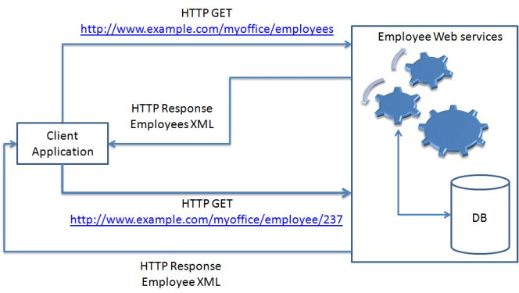
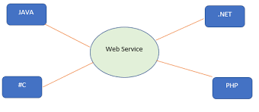
8. Web Services :
Basic Operation:
Definition: Web services are software systems designed to support
interoperable machine-to-machine interaction over a network.
They enable communication between various applications or systems regardless of the programming languages or platforms they are built on.
They typically use standard protocols like HTTP, XML, and JSON for communication and data representation.
Example: An example of a web service is a weather service that provides weather forecasts to various applications or websites.

Slide 3
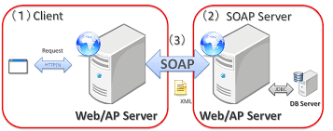
8. Web Services : SOAP
SOAP stands for Simple Object Access Protocol.
It is a XML-based protocol for accessing web services.
SOAP is a W3C recommendation for communication between two applications.
SOAP is XML based protocol. It is platform independent and language independent. By using SOAP, you will be able to interact with other programming language applications.
Advantages of Soap Web Services
WS Security: SOAP defines its own security known as WS Security.
Language and Platform independent: SOAP web services can be written in any programming language and executed in any platform.
Disadvantages of Soap Web Services
Slow: SOAP uses XML format that must be parsed to be read. It defines many standards that must be followed while developing the SOAP applications. So it is slow and consumes more bandwidth and resource.

Slide 4
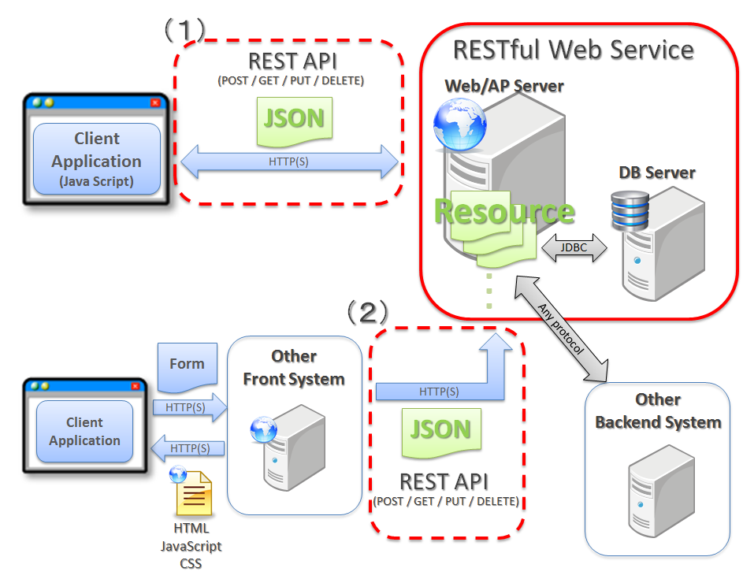
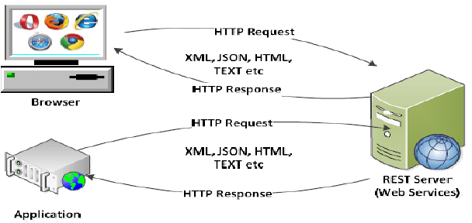
8. Web Services : RESTful
REST stands for REpresentational State Transfer.
REST is an architectural style not a protocol
Advantages of Soap Web Services
Fast: RESTful Web Services are fast because there is no strict specification like SOAP. It consumes less bandwidth and resource.
Language and Platform independent: RESTful web services can be written in any programming language and executed in any platform.
Permits different data format: RESTful web service permits different data format such as Plain Text, HTML, XML and JSON

Slide 5
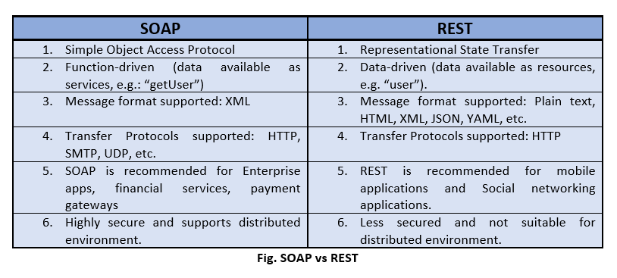
8. Web Services : SOAP vs RESTful

Slide 6
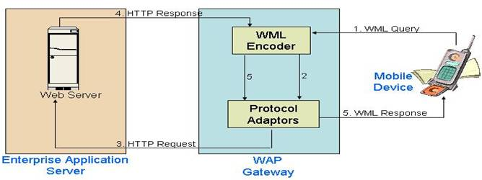
8. Web Services : WML
WML (Wireless Markup Language)
used for designing web pages intended for wireless devices such as mobile phones
It is based on XML and is used to create lightweight and efficient web content for mobile browsers
Explanation: WML is specifically designed for devices with limited processing power, memory, and display capabilities. It allows developers to create mobile-friendly web pages by defining elements like decks, cards, and menus optimized for small screens and limited input methods.

Slide 7
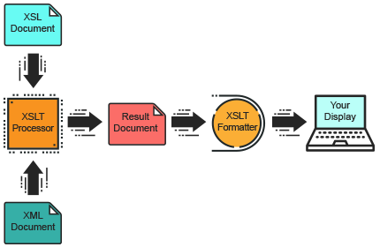
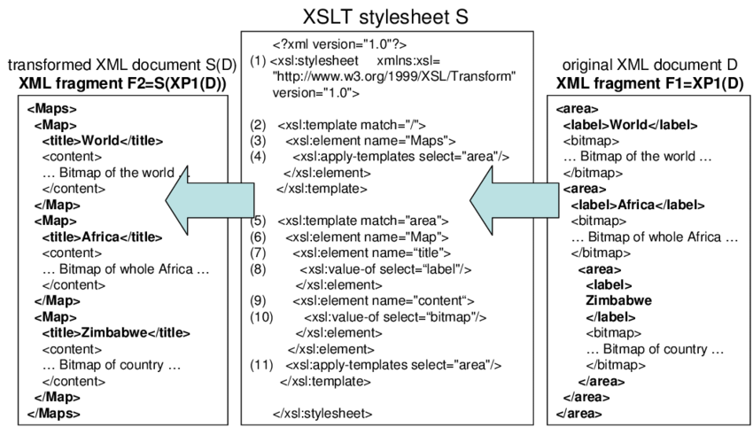
8. Web Services : XSL
XSL (Extensible Stylesheet Language)
XSL is a family of languages used to transform and render XML documents into different formats such as HTML, PDF, or plain text.
It consists of three parts:
XSLT for transforming XML documents,
XPath for navigating XML documents, and
XSL-FO for formatting XML documents.

